Slide 1
TRAFFIC MANAGEMENT SYSTEM

Slide 2
Abstract
Intelligence Traffic Management System (ITMS) provides effective and efficient solutions toward the road traffic management and decision making problems, and thus helps to reduce fuel consumption and emission of greenhouse gases, and increases the standard of sustainable living.
Software based real time bi-directional traffic management system (TMS) with Artificial Neural Network (ANN) was proposed and implemented. The proposed TMS solves a decision problem, dynamic road weights calculation, using different environmental, road and vehicle related decision attributes.
In addition, the development of the real time operational models as well as their solving challenges has increased in a rapid manner. Therefore, in this chapter, we integrate the design and development of a neural based complete real time operational ITMS, with the combination of software based modules including traffic monitoring, road weight updating, forecasting, and optimum route planning decision.

Slide 3
Technical Specifications
HARDWARE:
Rectifier
Regulator
Power Supply
LCD Display
Wifi Module
Led’s
Atmega 328 Microcontroller
IR Sensors
Resistors
Capacitors
Diodes
SOFTWARE:
Arduino Compiler
MC Programming Language: C

Slide 4
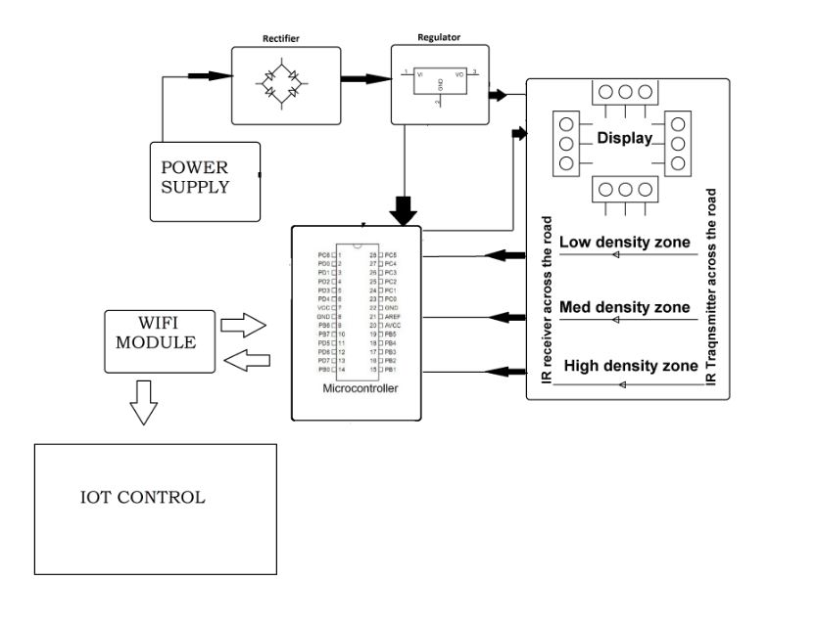
Block Diagram

Slide 5


